Slide 1
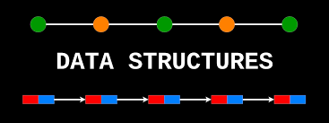
DATA STRUCTURES USING C
22BCA2C05

Slide 2
Pointers
The pointer in C language is a variable that stores the address of another variable. This variable can be of type int, char, array, function, or any other pointer.
Example
int n = 10;
int* p = &n; // Variable p of type pointer is pointing to the address of the variable n of type integer.

Slide 3
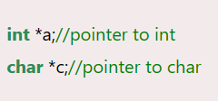
Declaring a pointer
The pointer in c language can be declared using * (asterisk symbol). It is also known as an indirection pointer used to dereference a pointer.
Notes:
Dereferencing is used to access or manipulate data contained in memory location pointed to by a pointer. *(asterisk) is used with pointer variable when dereferencing the pointer variable, it refers to variable being pointed, so this is called dereferencing of pointers.

Slide 4
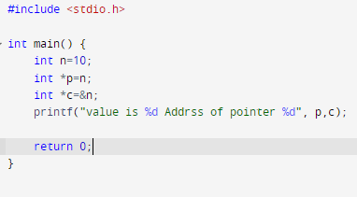
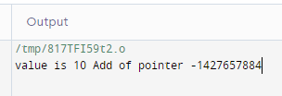
Example

Slide 5
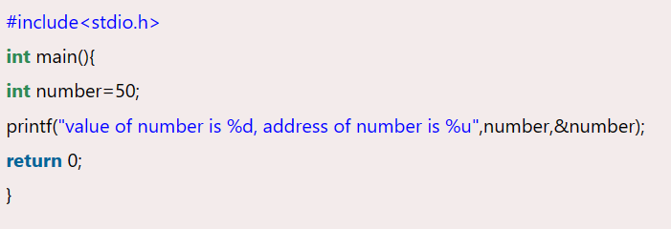
Advantage of pointer
1) Pointer reduces the code and improves the performance, it is used to retrieve strings, trees, etc.
2) We can return multiple values from a function using the pointer.
3) It makes you able to access any memory location in the computer's memory.
Address Of (&) Operator
The address of operator '&' returns the address of a variable. But, we need to use %u to display the address of a variable.

Slide 6
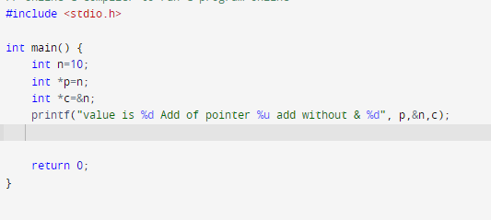
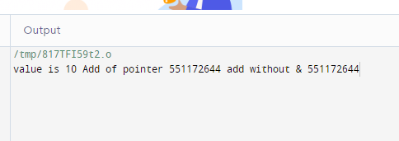
Example
Notes:
#include <stdio.h>int main() { int n=10; int *p=n; int *c=&n; printf("value is %d Add of pointer %u add without & %d", p,&n,c); return 0;}

Slide 7
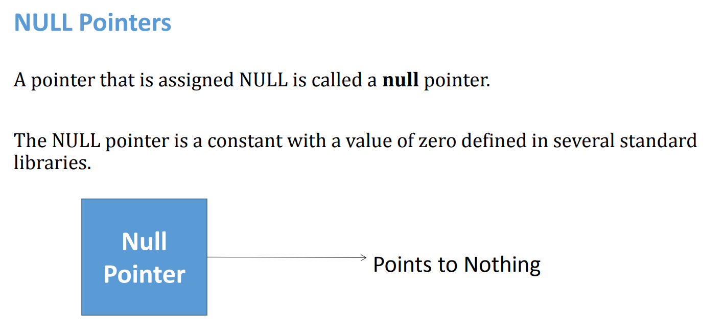


Slide 8
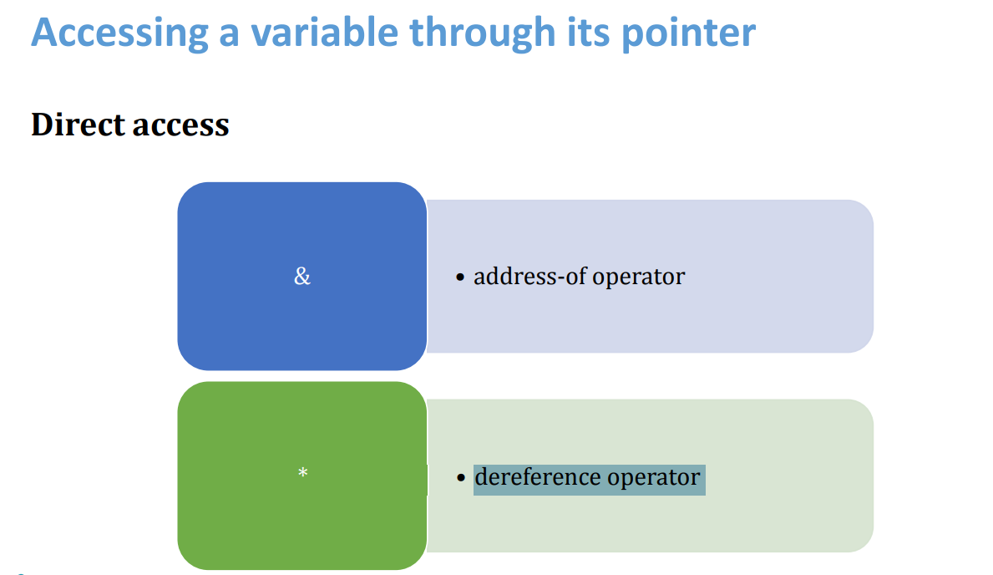
Dereference operator, also known as an indirection operator, operates on a pointer variable. It returns the location value
Notes:
a dereference operator, also known as an indirection operator, operates on a pointer variable. It returns the location value, or l-value in memory pointed to by the variable's value.

Slide 9
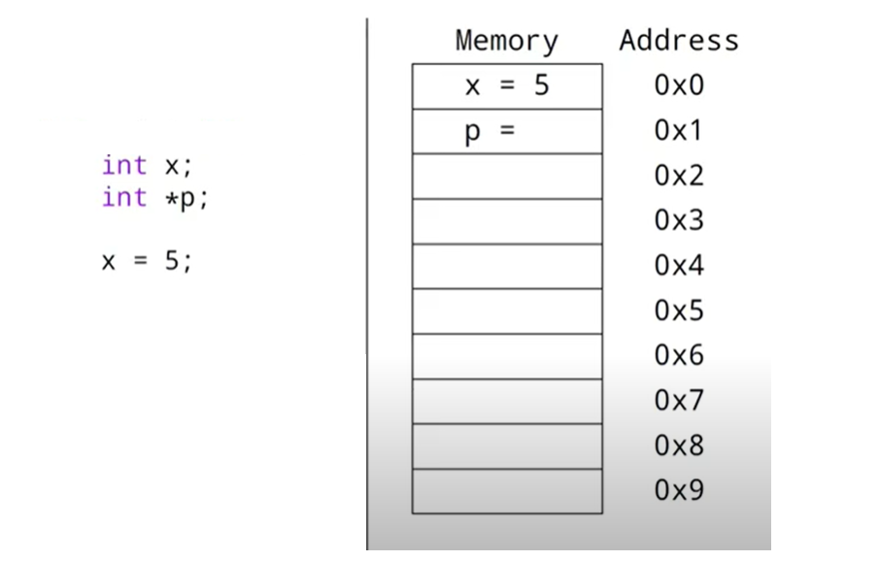
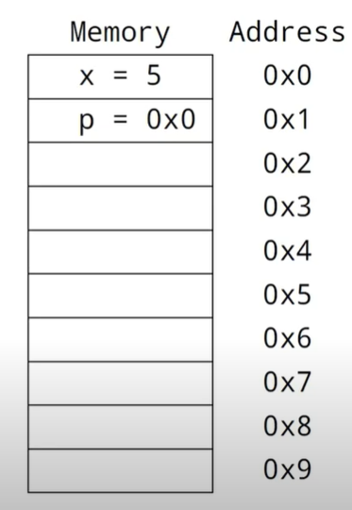

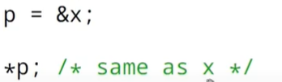

Slide 10
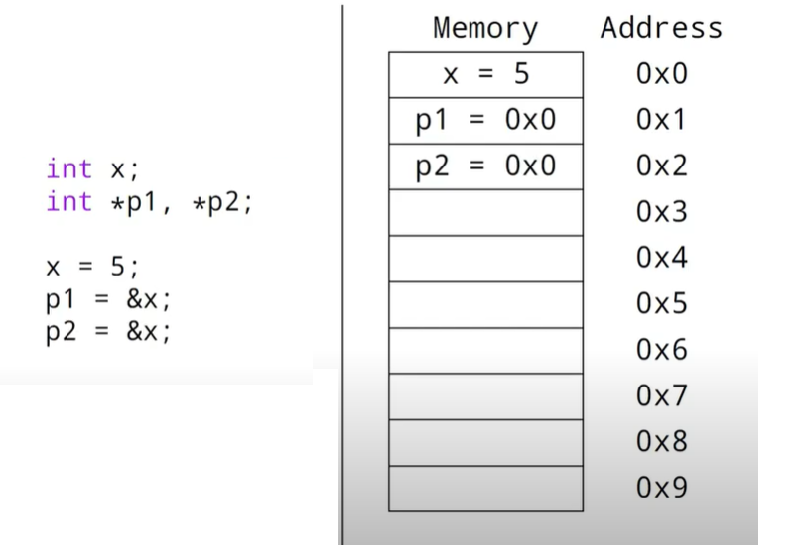





Slide 11
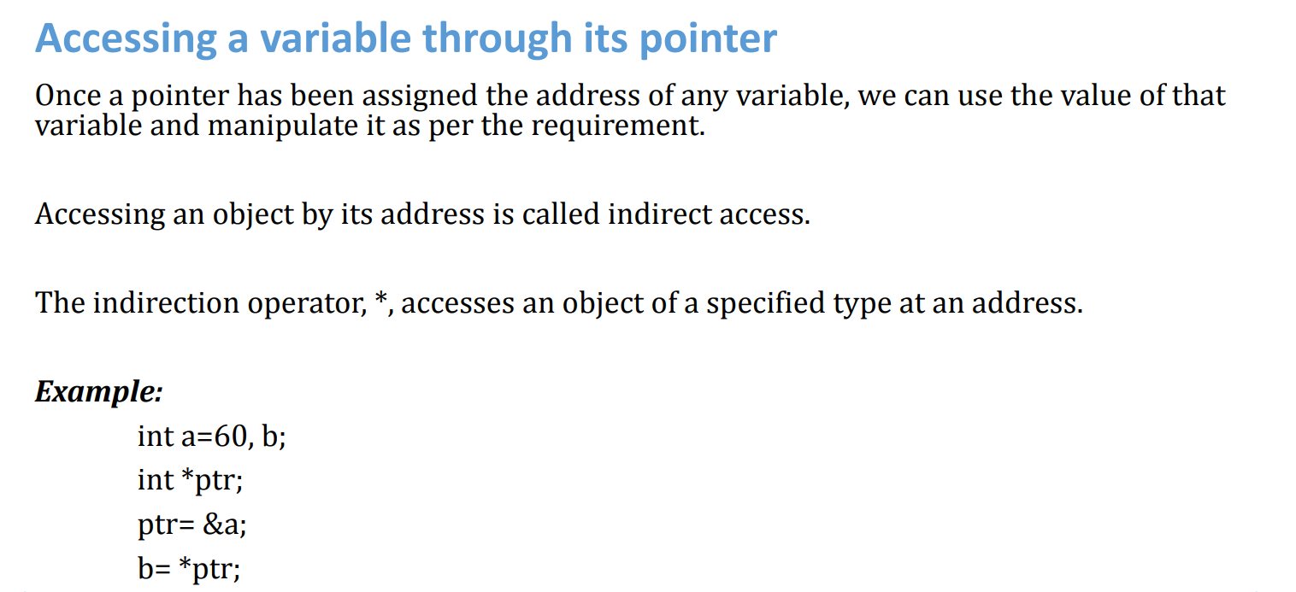

Slide 12
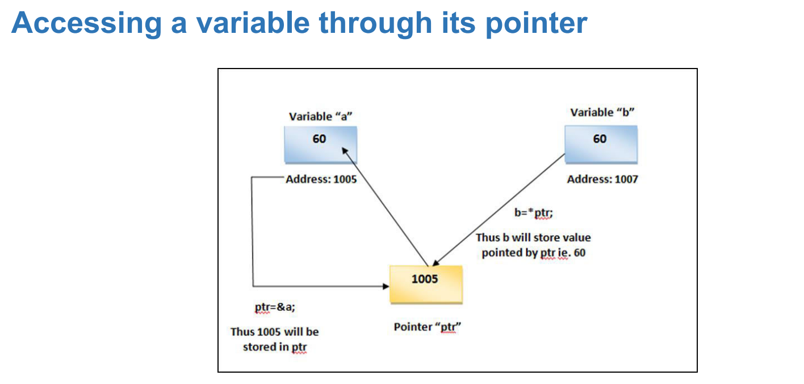

Slide 13
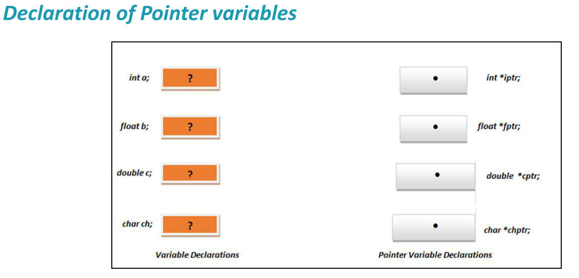

Slide 14
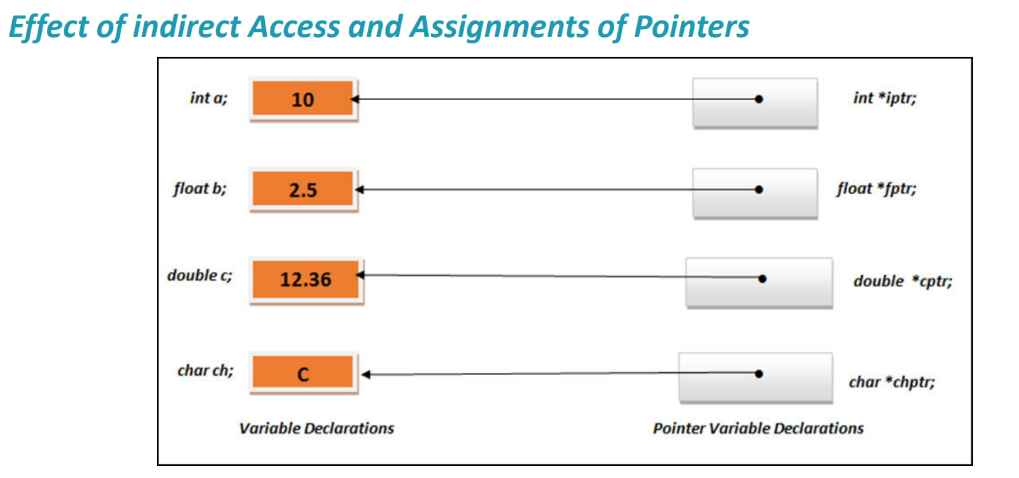

Slide 15
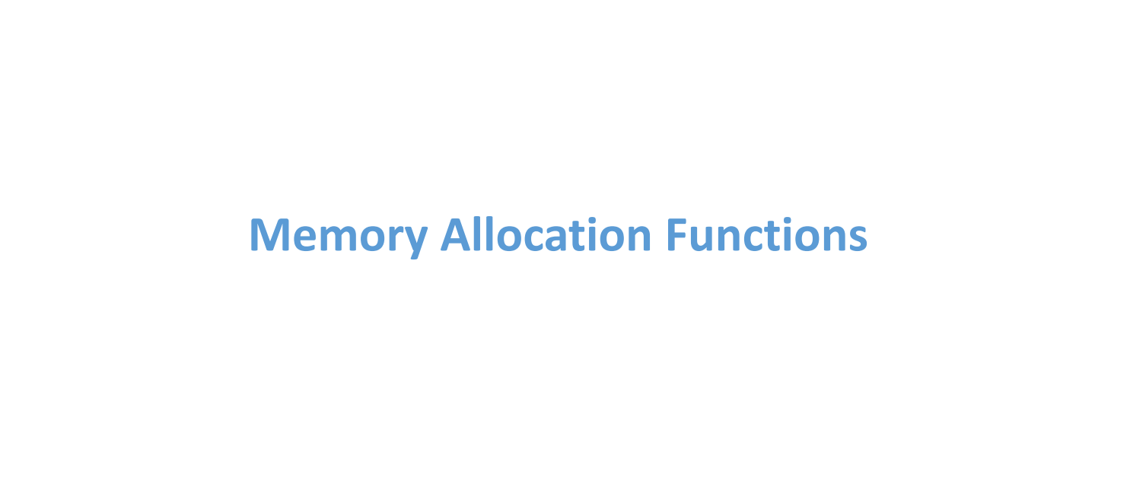

Slide 16
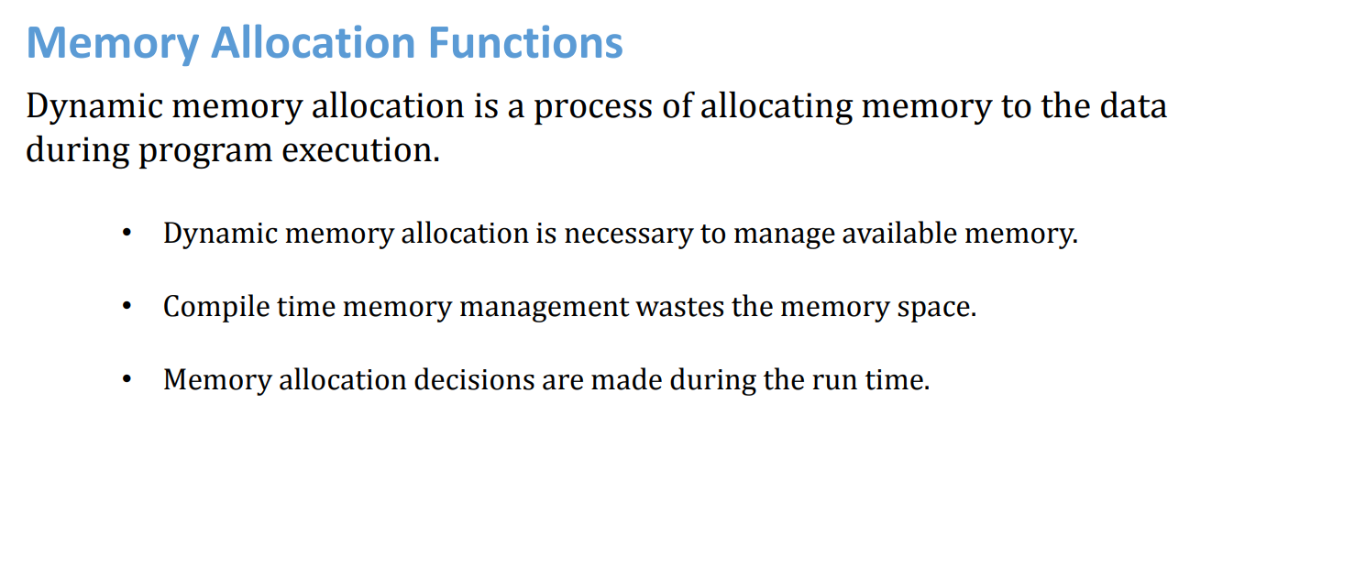
These functions are defined in the stdlib.h header file.

Slide 17
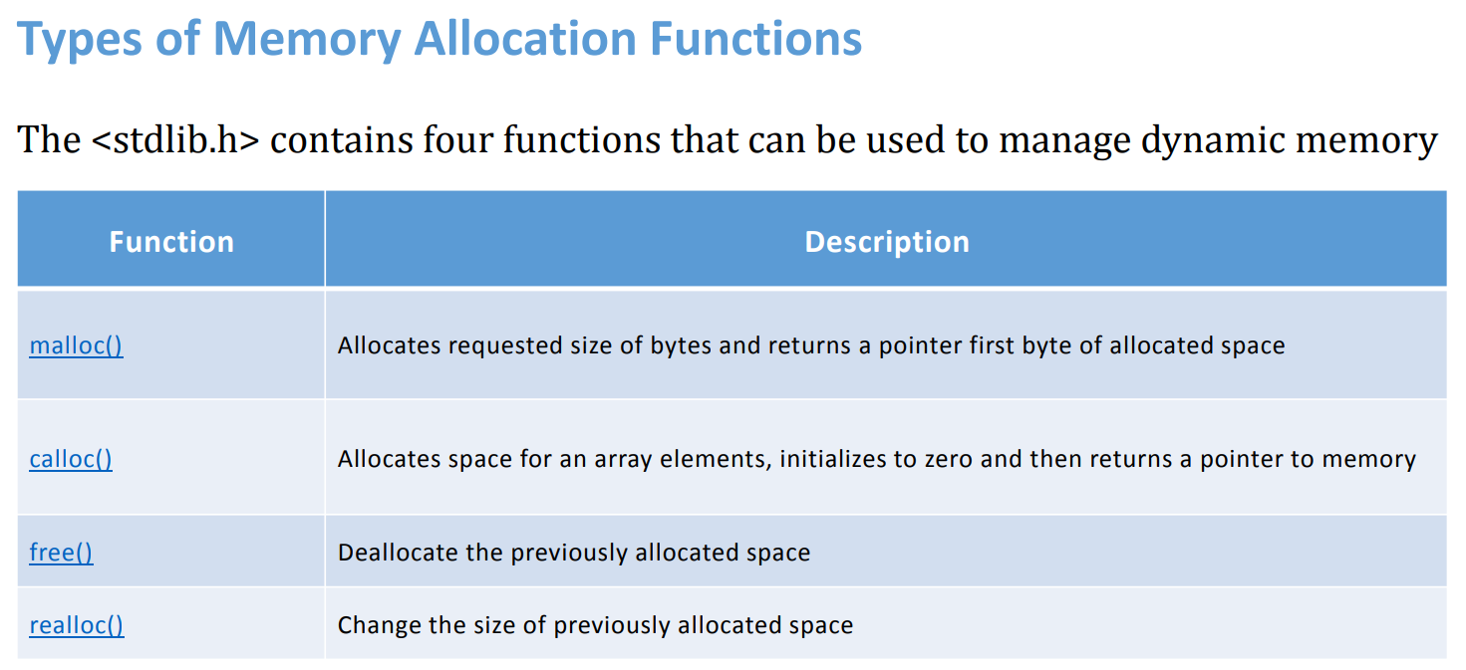

Slide 18
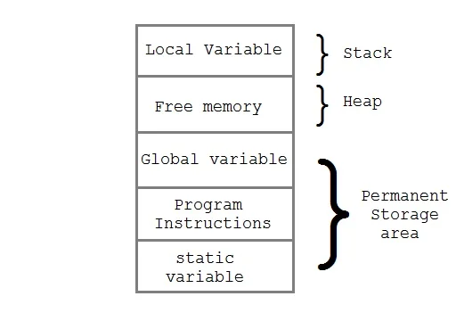
Memory Allocation Process
Global variables, static variables and program instructions get their memory in permanent storage area whereas local variables are stored in a memory area called Stack.
The memory space between these two region is known as Heap area. This region is used for dynamic memory allocation during execution of the program. The size of heap keeps changing.
Notes:
The memory is allocated during the execution of instructions written by programmers. Note that the name heap has nothing to do with the heap data structure. It is called a heap because it is a pile of memory space available to programmers to allocate and de-allocate.

Slide 19

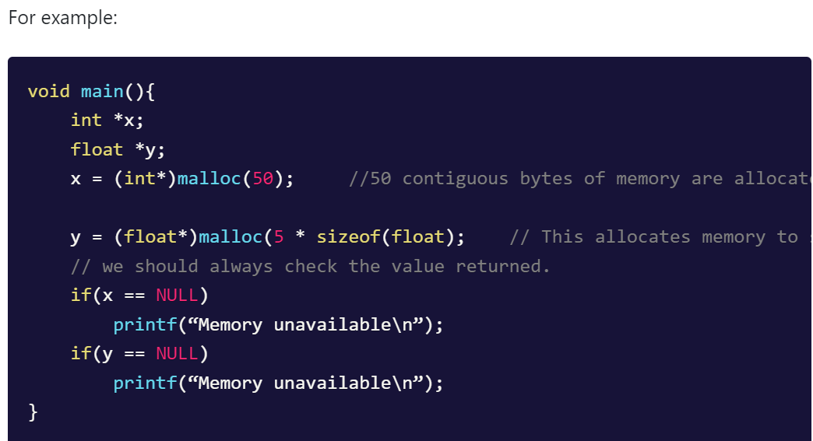
malloc() function is used for allocating block of memory at runtime. This function reserves a block of memory of the given size
void* malloc(size_t size)

Slide 20

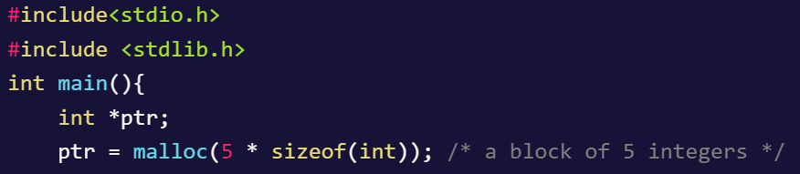

Slide 21
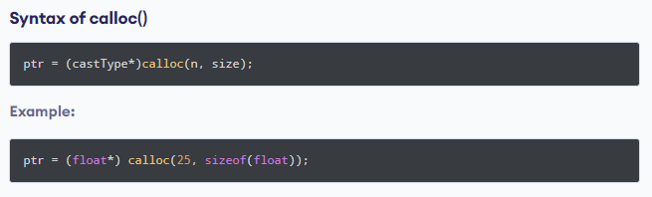
calloc() Function
calloc() is another memory allocation function that is used for allocating memory at runtime. calloc function is normally used for allocating memory to derived data types such as arrays and structures. If it fails to allocate enough space as specified, it returns a NULL pointer.

Slide 22
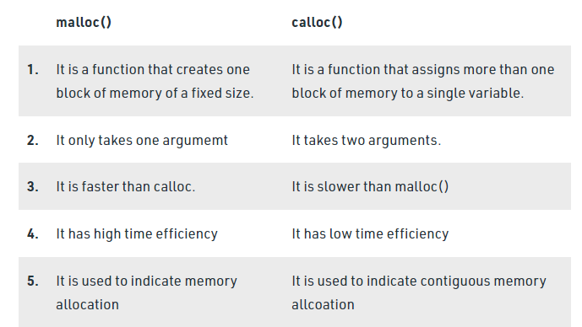
Difference between malloc() and CALLOC()

Slide 23
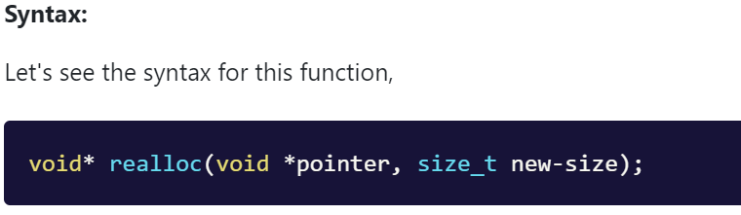
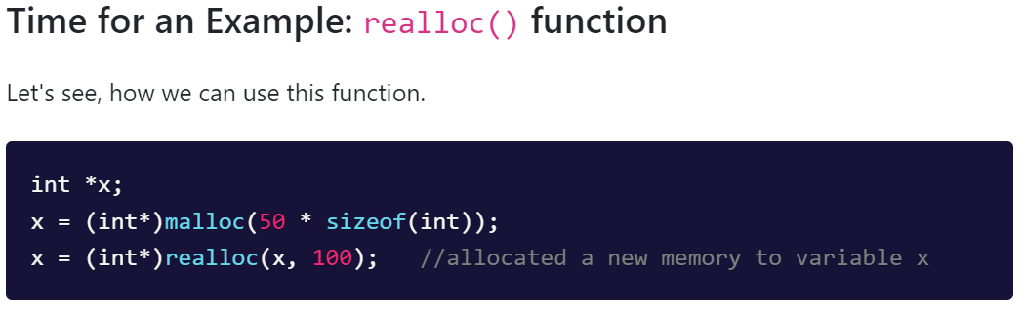
realloc() Function
The realloc() function is used to change the memory size that is already allocated dynamically to a variable
If we want to change the size of memory allocated by malloc() or calloc() function, we use realloc() function. Without losing the old data, it changes the size of the memory block

Slide 24
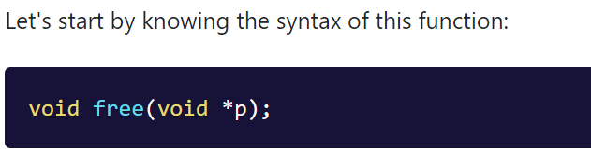
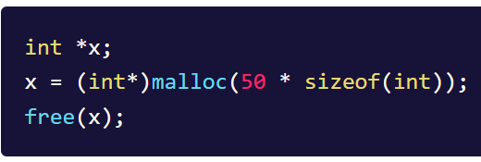
free() Function
Example

Slide 25
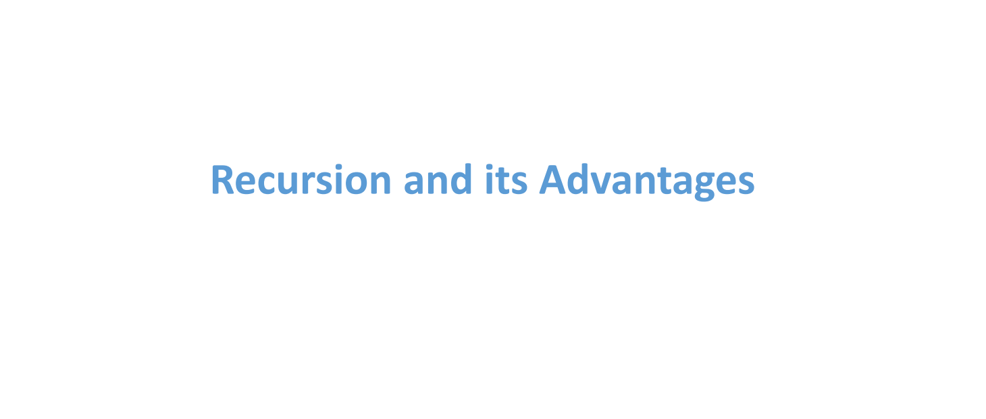

Slide 26
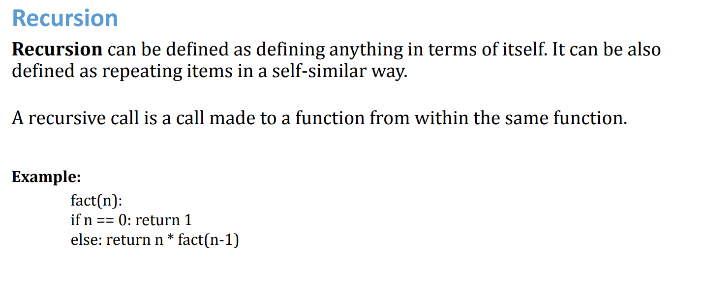

Slide 27
Conditions for recursion
Performing the same operations multiple times with different inputs.
Base condition is needed to stop the recursion otherwise infinite loop will occur.
In every step, we try smaller inputs to make the problem smaller.

Slide 28
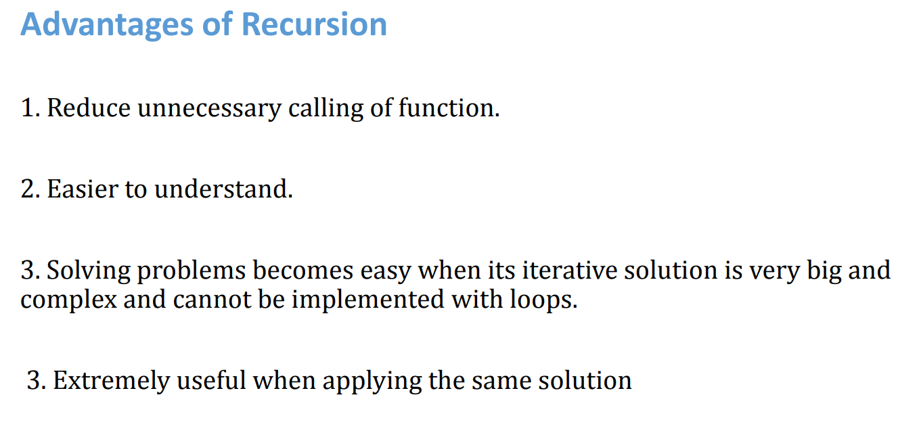

Slide 29
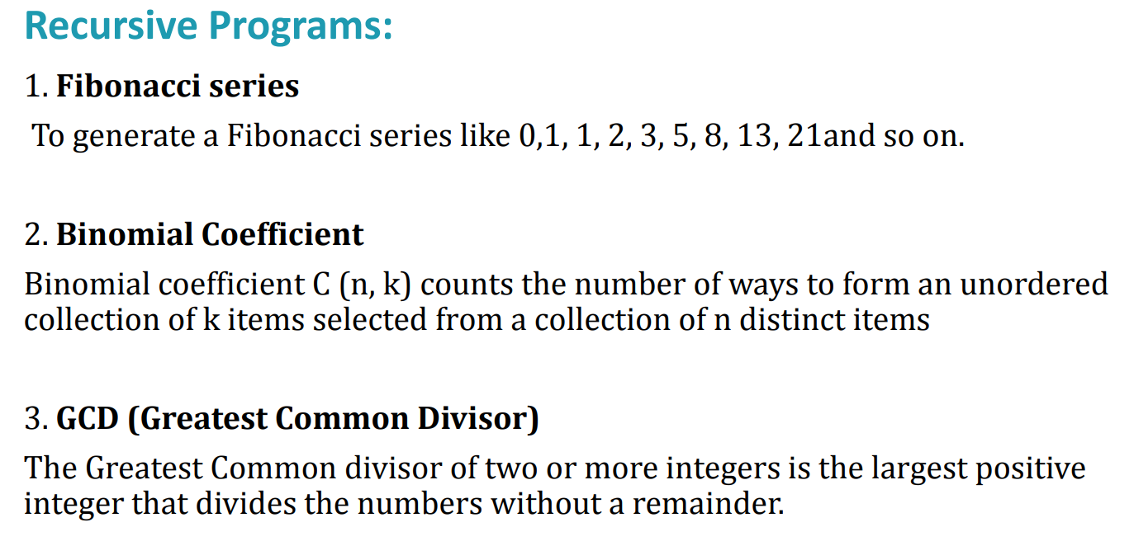

Slide 30
Thank you

